Slide 1
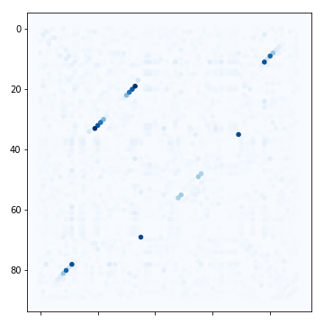
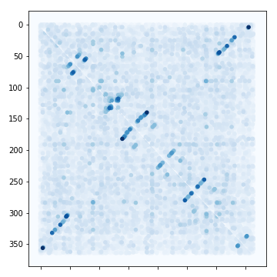
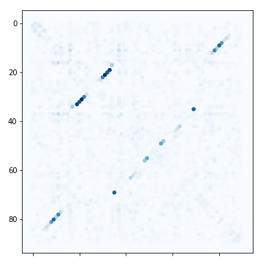
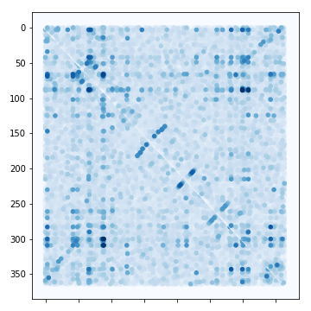
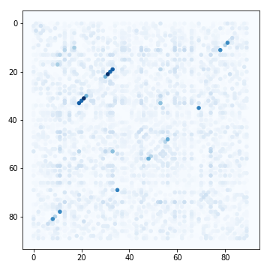
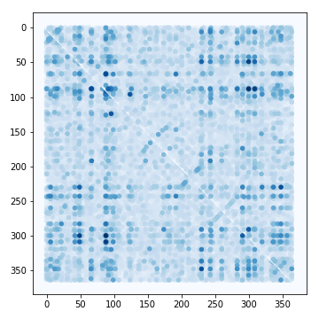
A
B
Supplementary Figure X: Example SoM results from MLPs trained on shallower training sets of (A) Glycine Riboswitch – RF00504 (an alignment of 91 nucleotides in length) and (B) transfer-messenger RNA – RF00023 (an alignment of 366 length). The SoM results get less clear as the training size decreases for both families, suggesting that depth of training set is an important factor that influences an MLPs ability to learn structure. The results for MLPs trained on Glycine Riboswitch seems to be more robust to lower training sizes, suggesting that even with shallow training sets, an MLP can still learn structure if the alignment is short.

